Slide 1
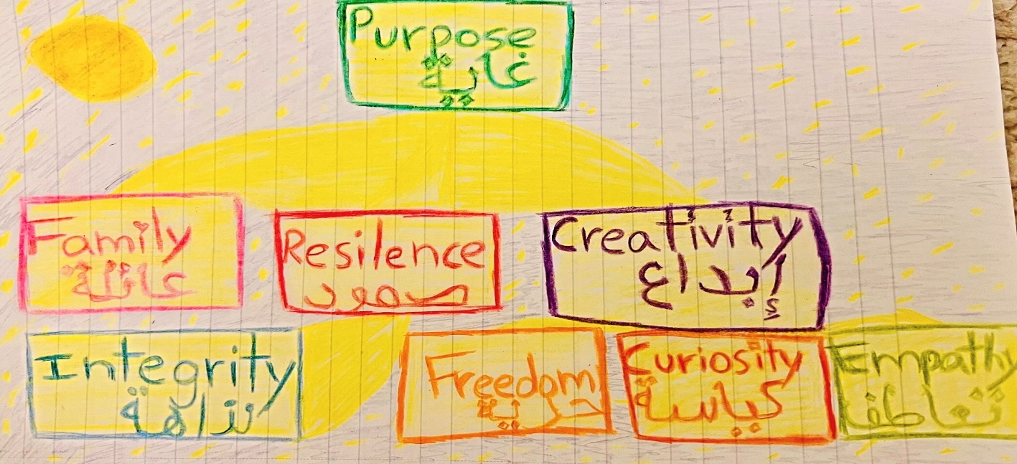
Nicole Jones

Slide 2
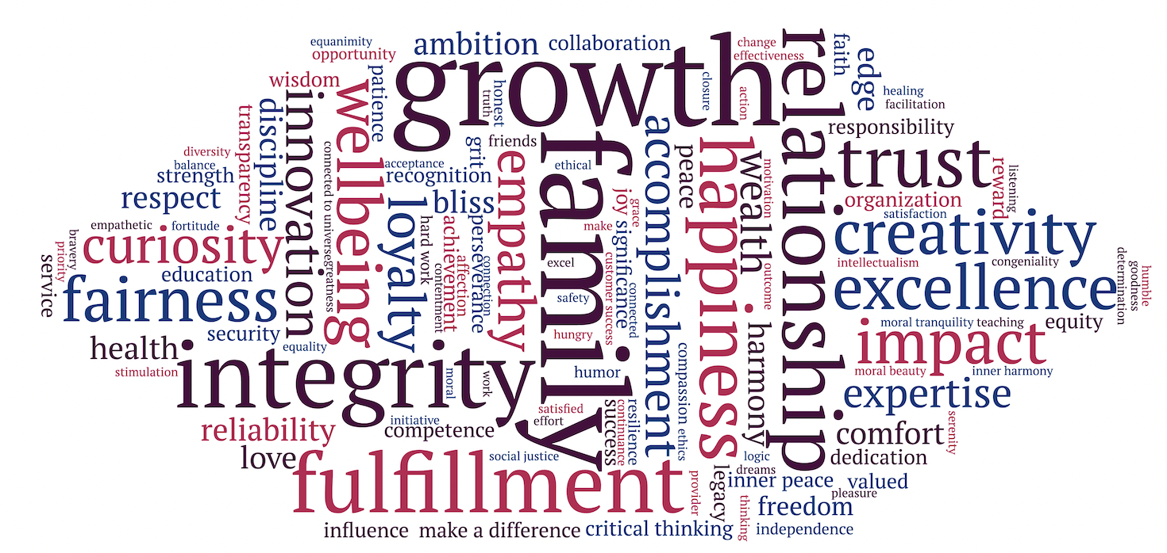

Slide 3
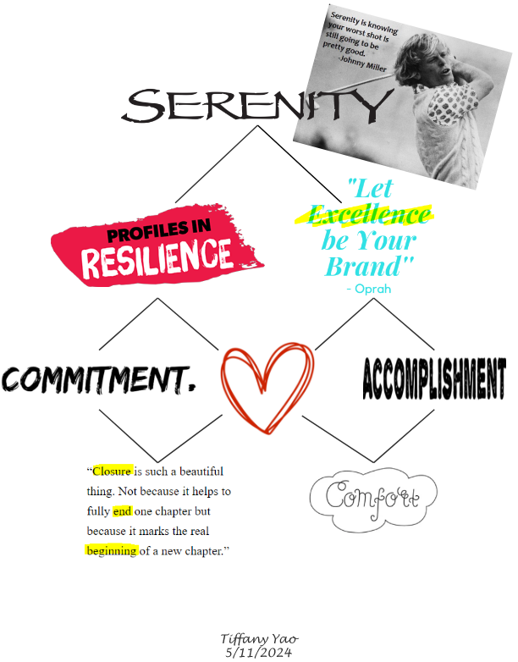
Tiffany Yao

Slide 5
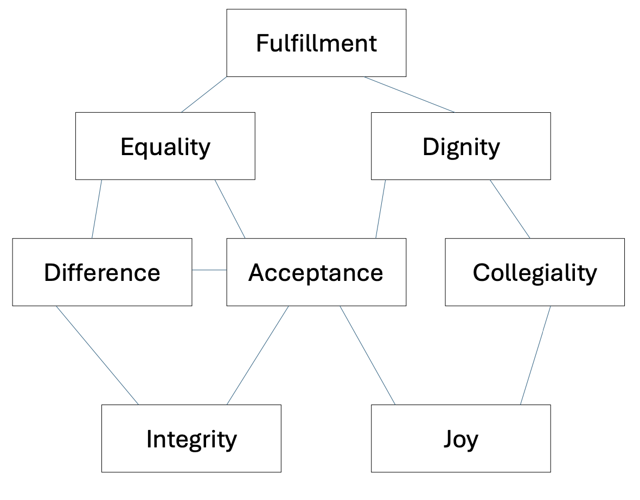
Greg Jones

Slide 7

Haley Clint
Gauri BansalGauri BansalGauri Bansal

Slide 9
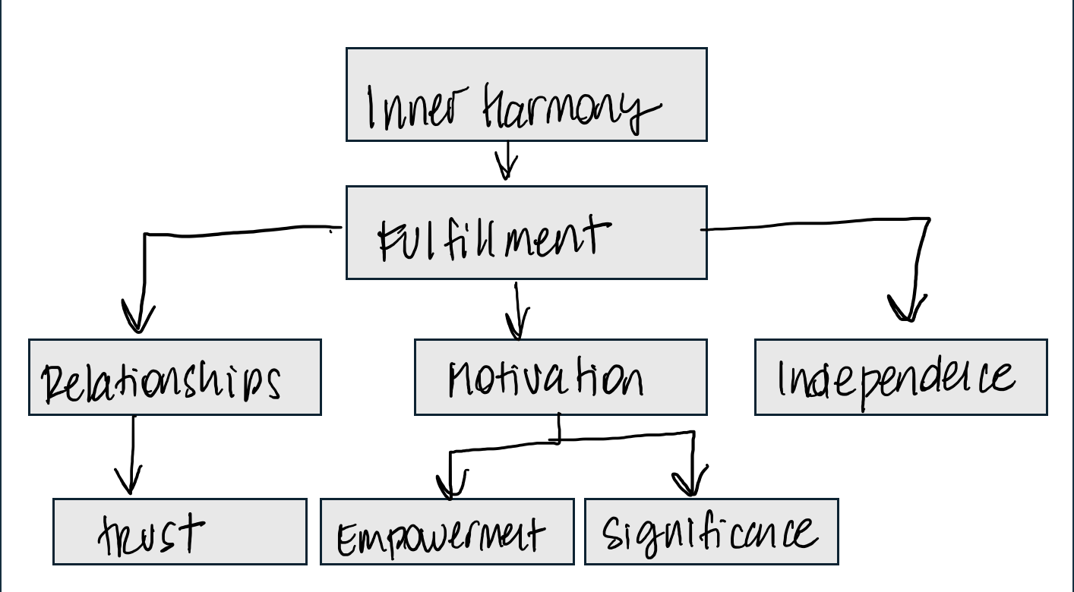
Agustina Mortola Saiach
Gauri BansalGauri BansalGauri Bansal

Slide 11
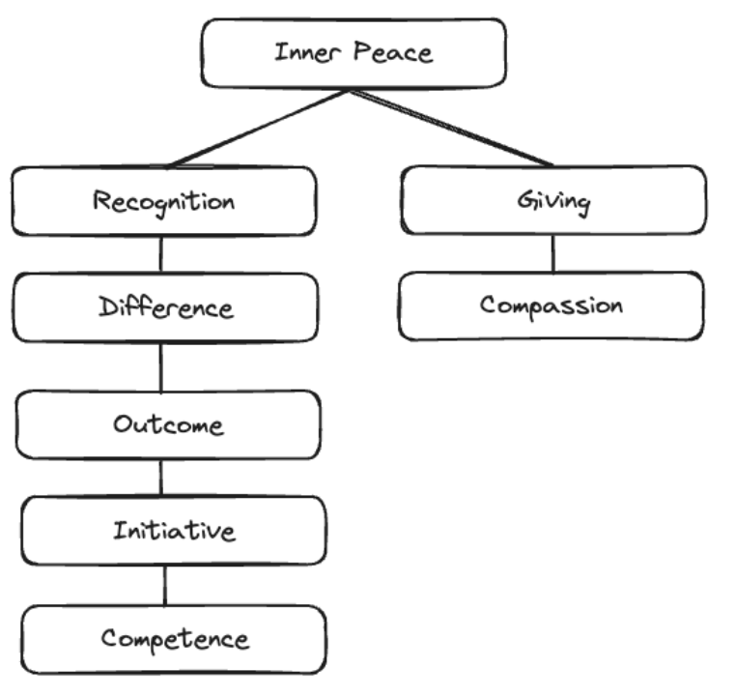
Sung Hong
Gauri BansalGauri BansalGauri Bansal

Slide 13
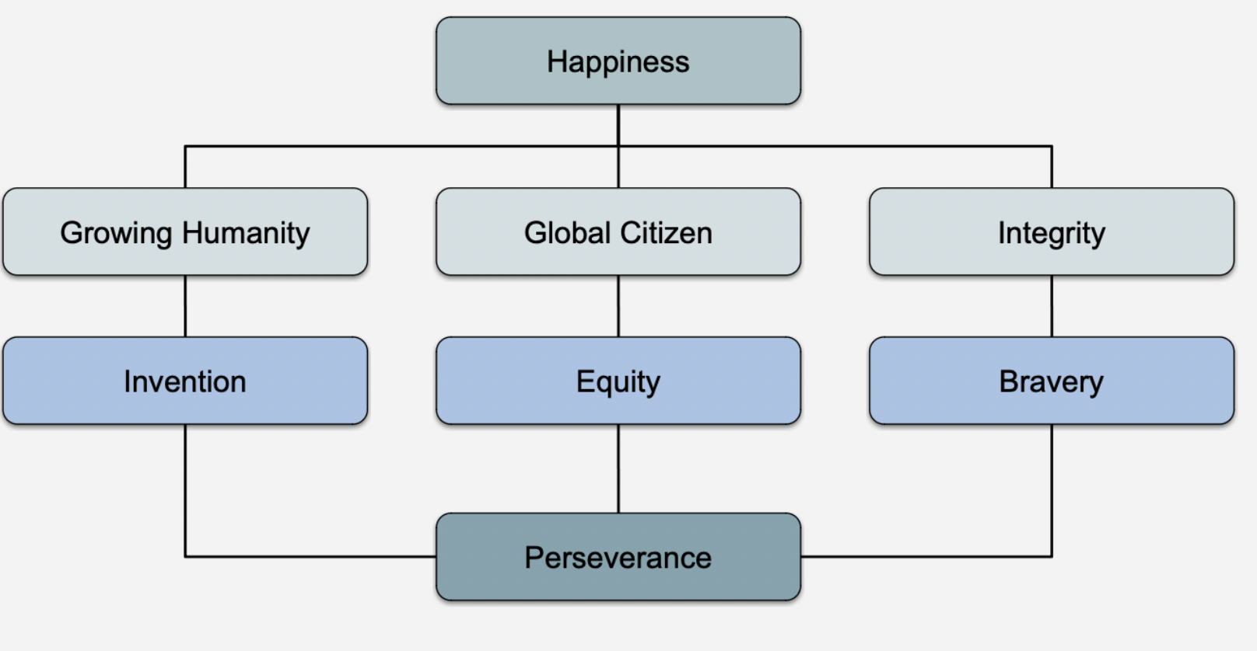
Aayush Srivastava
Gauri BansalGauri BansalGauri Bansal

Slide 15
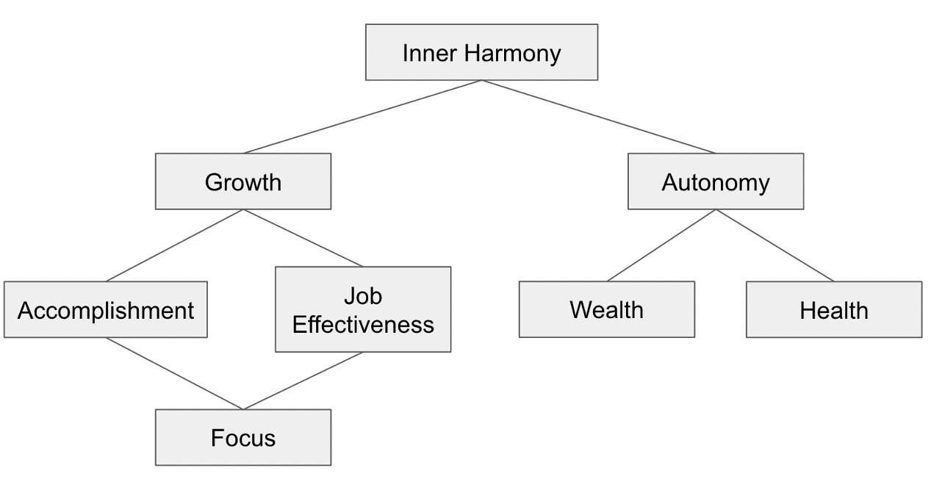
Rishav Binayak Das
Gauri BansalGauri BansalGauri Bansal

Slide 17
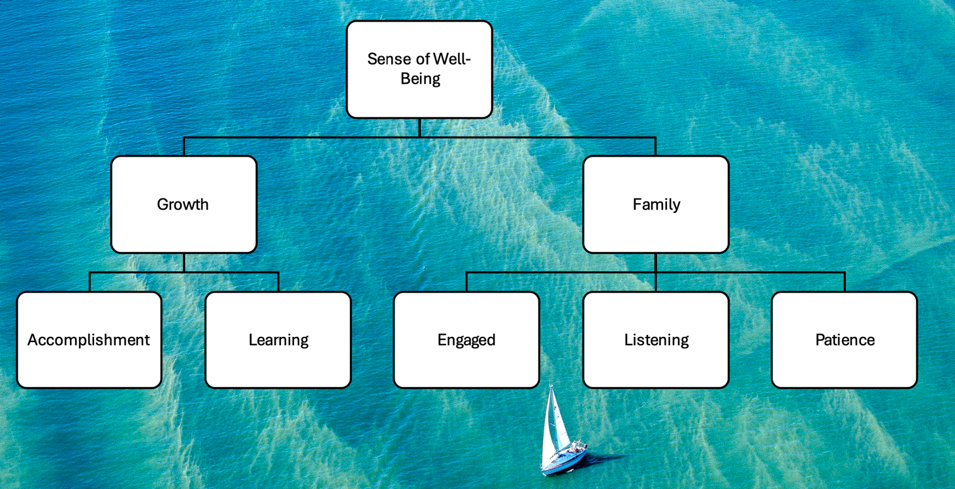
Jordan Lustig
Gauri BansalGauri BansalGauri Bansal

Slide 19
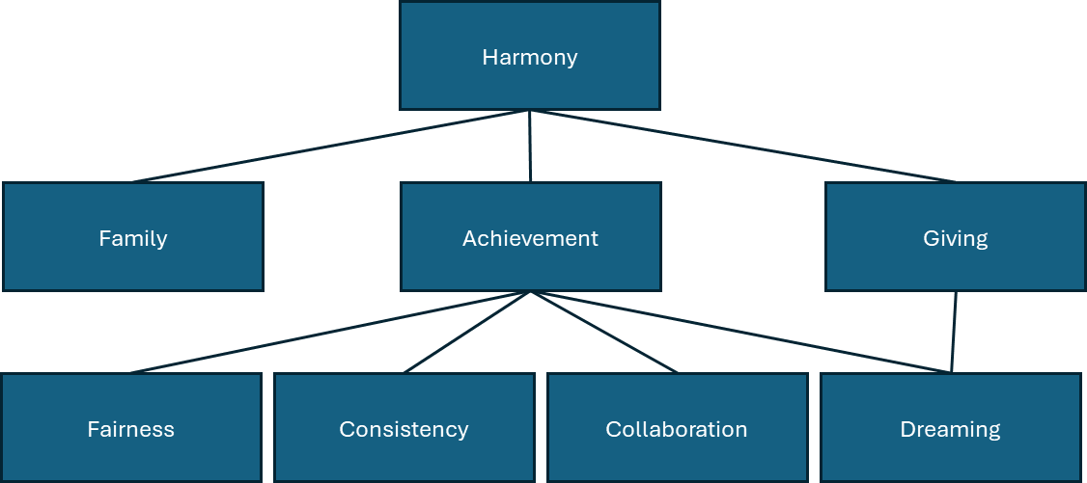
Hasim Turhan

Slide 21
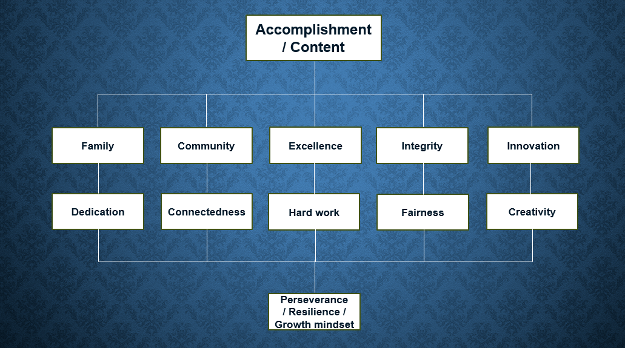
Lara Sleiman

Slide 23
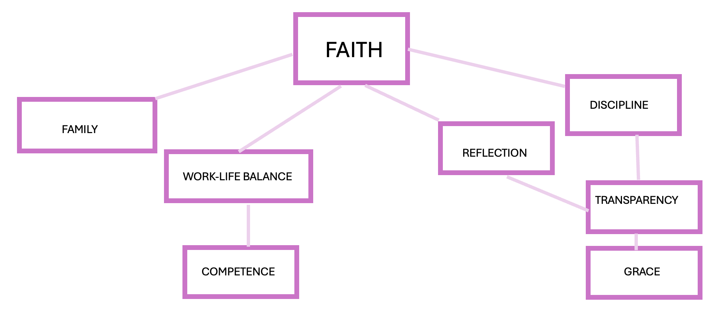
Krystal Sewell

Slide 25
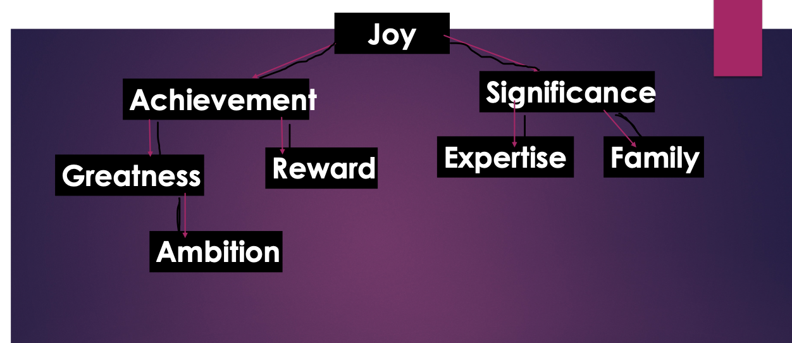
Cindy Morand

Slide 27
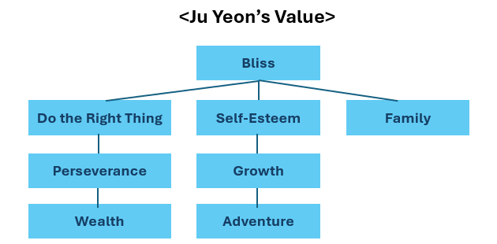
Ju Yeon Lim

Slide 29
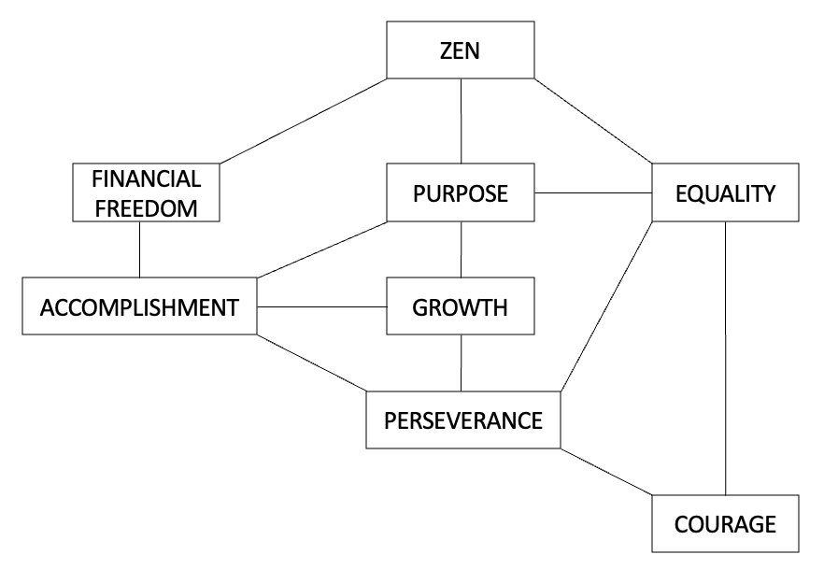
Andrea Edwards

Slide 31
Sanatkumar Dhir

Slide 33
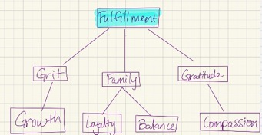
Stephanie Eldridge

Slide 35
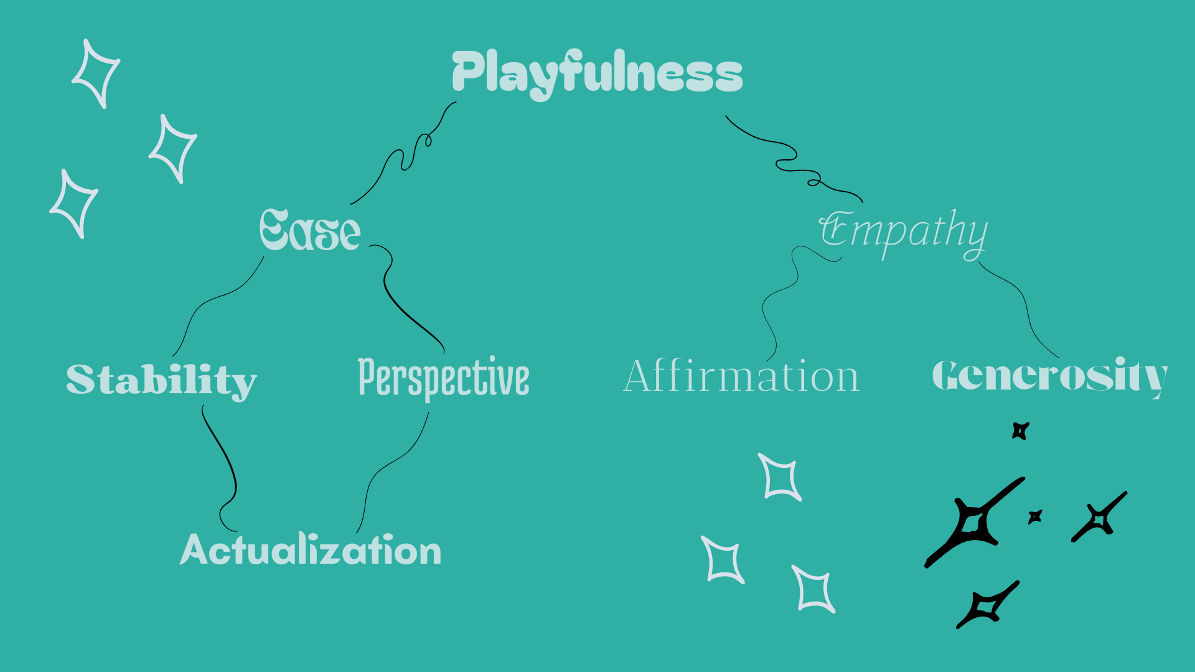
Christopher Fell

Slide 37
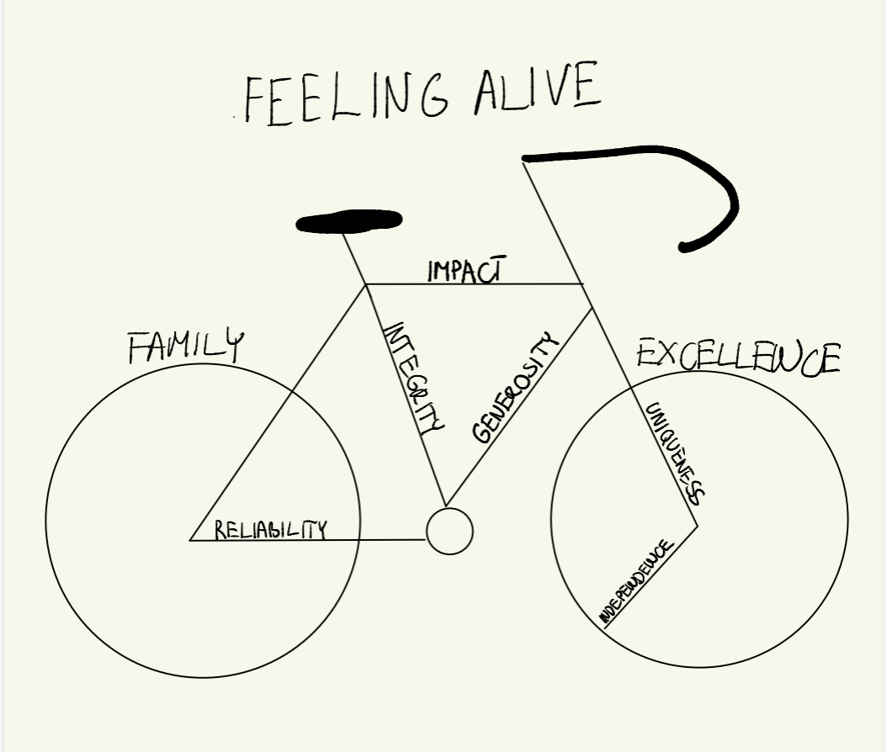
Annamaria Garancsi

Slide 39
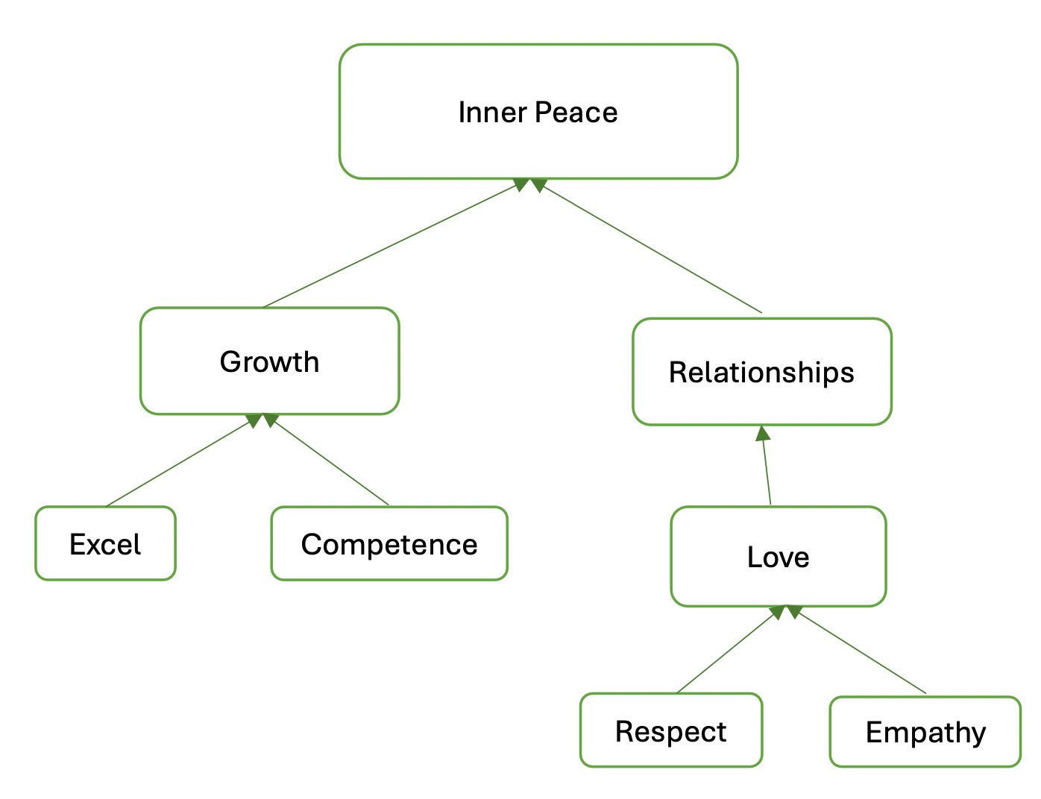
Swapnil Dhalwade

Slide 41

Alla Mikhalevsky

Slide 43
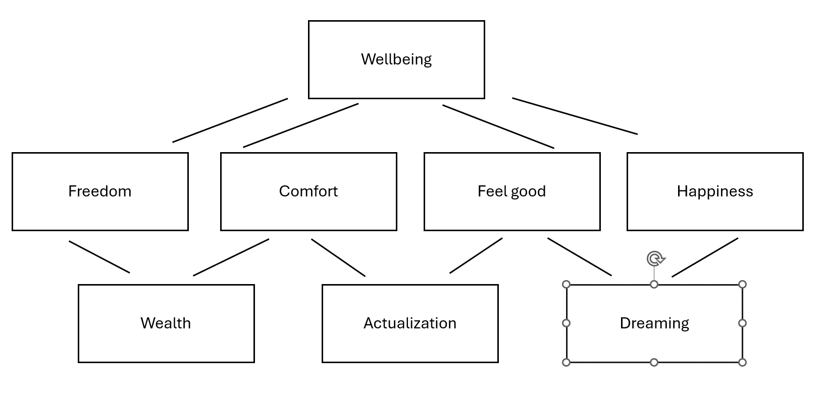
Min Young Son

Slide 45
Brittney Destin

Slide 47
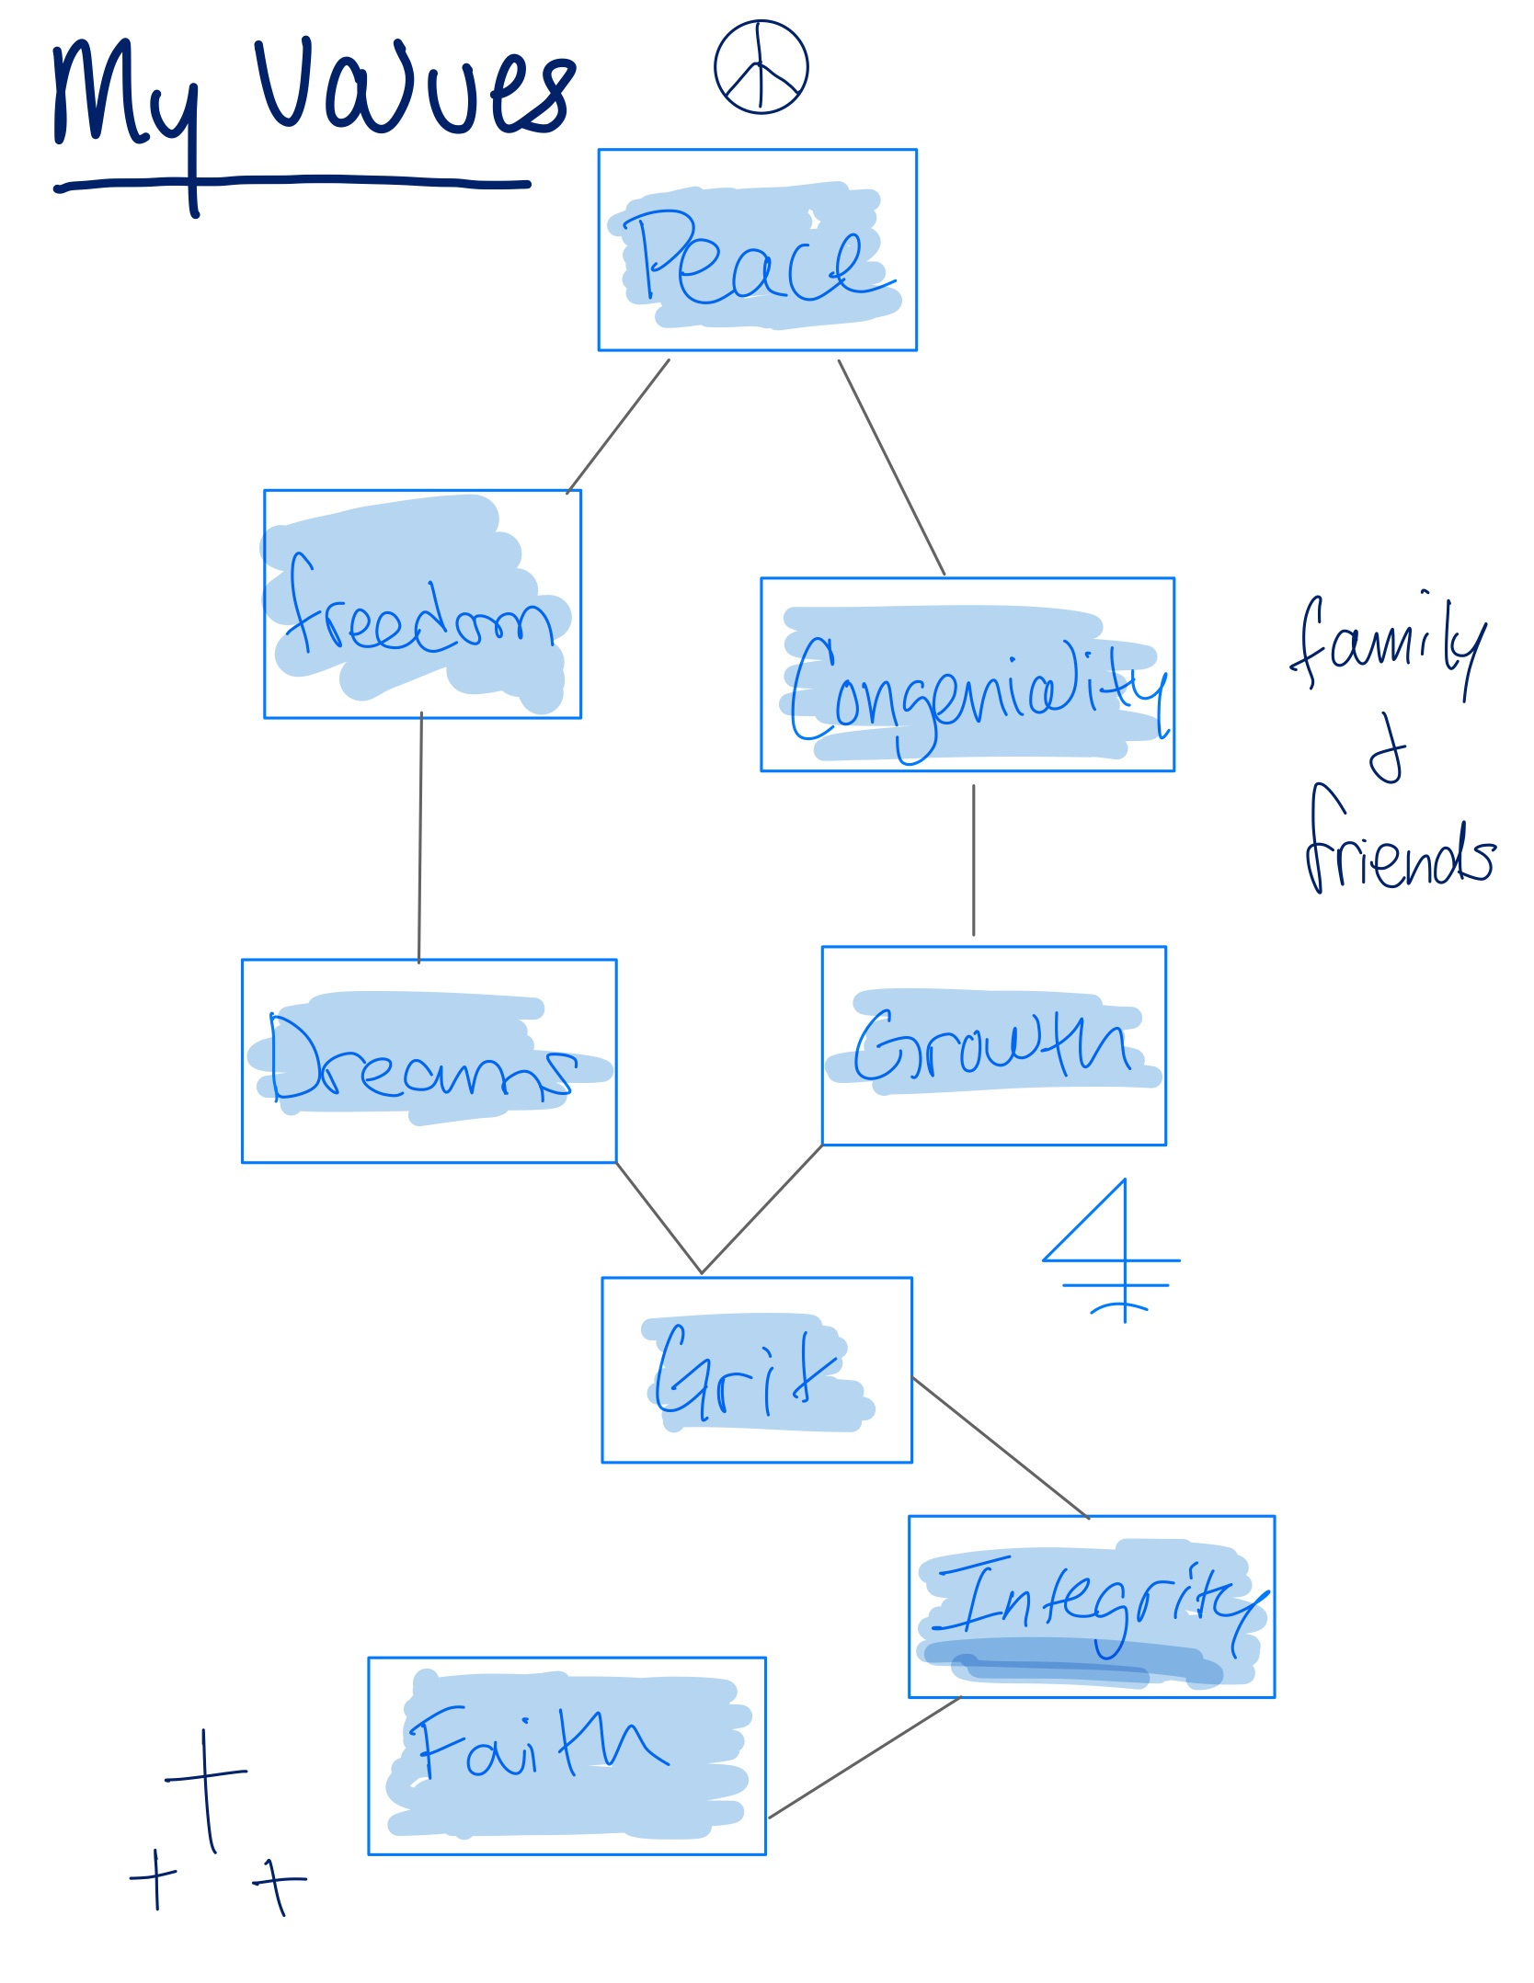
Johan Francois

Slide 49
Avery Peace

Slide 51
Min Young Son
Notes:
Repeated

Slide 53
Chenchao Gao
Satisfaction
Recognition
Family
Wealth
Achievement
Organization
Opportunity
Wisdom

Slide 55
Suzana Gorenc Eskelin Leaton
Well-Being
Relationship
Experience
Growth
Bliss
Empathy
Integrity
Dreaming

Slide 57
Lindsay Grant
Harmony
Family/Friends
Health
Integrity
Curiosity
Kindness
Service

Slide 59
William Jundanian
Happiness/Love
Independence
Respect
Dedication
Relationships
Education
Playfulness
Connected to the Universe

Slide 61
Martina Kaltenboeck
Growth
Opportunity
Freedom
Empowerment
Innovation
Discipline
Kindness
Curiosity

Slide 63
Matthew Lavelle
Well-being
Organization
Purpose
Education
Service
Communication
Hard Work
Family+Friends

Slide 65
Matthew McCrane
Wisdom
Healing
Truth
Fortitude
Teaching
Discovery
Reliability
Affection

Slide 67
Isaac Miller
Contentment
Relationship
Accomplishment
Positivity
Effectiveness
Humor
Reliability
Problem Solving

Slide 69
Casey Mott
Accomplishment
Growth
Family
Curiosity
Opportunity
Provider
Comfort
Wealth

Slide 71
Ameya Naik
Pleasure
Validation
Discovery
Relationships
Accomplishments
Collaboration
Humor
Strong work ethics

Slide 73
Grant Palmer
Peace
Accountability
Family
Generosity
Expertise
Ethical
Free Expression
Trust

Slide 75
Rohin Patel
Equanimity
Health
Impact
Family
Learning
Influence
Goodness
Affection

Slide 77
Siddhant Pyasi
Excellence
Edge
Loyalty
Effort
Innovation
Rigor
Family

Slide 79
Anansha Roy Choudhry
Bliss
Love
Mindfulness
Passion
Creativity
Freedom
Stimulation
Integrity

Slide 81
Joan Baptista Tapia Boil
Happiness
Excellence
Family
Recognition
Challenge
Curiosity
Security Well being
Ethics

Slide 83
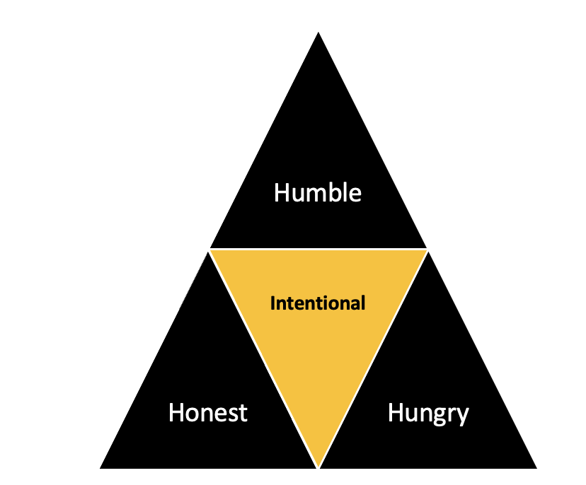
Mitchell Urena

Slide 85
Luis Zabala Hines
Inner Peace
Fulfillment
Positivity
Family
Affection
Critical Thinking
Loyalty
Transparency

Slide 87
Bryant Dang
Feeling Active
Strength
Fulfillment
Significance
Edge
Action
Recognition
Job Effectiveness

Slide 89
Pranav Chunduri
Inner Peace
Impact
Family
Teamwork
Diversity
Empathy
Creativity
Playfulness

Slide 91
Jason Choi
Happiness
Acceptance
Work-life Balance
Job Effectiveness
Humor
Joy
Comfort
Improvement

Slide 93
Michele Chiacchio
Legacy
Influence
Difference
Wealth
Family
Significance
Philanthropic
Empathetic

Slide 95
Pantelis Callaway
Fulfilment
Valued
Family
Impact
Trust
Security
Patience
Ambition

Slide 97
Anika Bhardwaj
Success
Critical Thinking
Innovation
Edge
Moral Beauty
Hard work
Family
Strength

Slide 99
Paul Balasubramanian
Legacy
Make a difference
Family
Work Job/My Company
Love
Achievement
Trust
Creativity

Slide 101
Mithun Manaswani
Well Being
Family
Accomplishment
Dependability
Growth
Mindfulness
Authenticity
Fairness

Slide 103
Akshay Kottala
Inner Peace
Health
Autonomy
Relationship
Persistence
Intellect
Love
Success

Slide 105
Lloyd Abraham
Happiness
Freedom
Expertise/ Respect
Family & Friends
Resilience
Ambition
Dependency
Loyalty

